Slide 1
Dialogs in MVVM
Karl Shifflett
Program Manager, Microsoft patterns & practices

Slide 2
Dialogs
Dialogs display information and optionally allow the user to select or enter information, or choose an execution path.
Types of Dialogs
Information
Exception Notification
Confirmation
File Open
File Save
Folder Browser
Color Picker
Custom

Slide 3
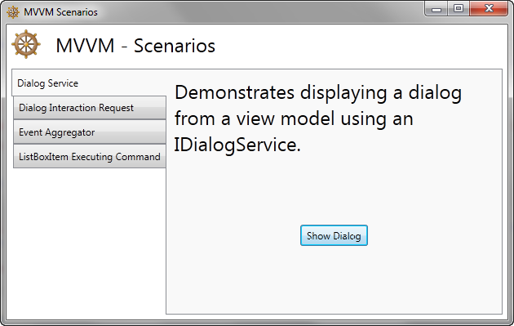
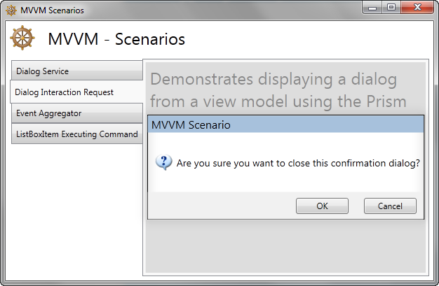
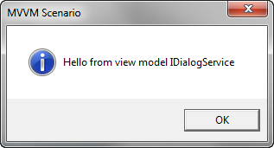
Dialog Experience
Application model or non-modal, task model or non-modal
Toast or dynamic list like Visual Studio Errors list
Handling multiple messages originating from multiple threads

Slide 4
Demo
Application Modal, Task Modal Dialog
MVVM Training Scenarios

Slide 5
ViewModel and View Communication
Approaches
Mediator
Events
Interfaces
Data binding
Dialog service
Prism Interaction Request
ViewModel and UI Communication
Dialog service

Slide 6
Concept: Program to an Interface not to Implementation
Why program to Interfaces?
Programming to an Interface enables the swapping of a concrete implementation.
Enables run-time implementation to differ from test-time implementation.

Slide 7
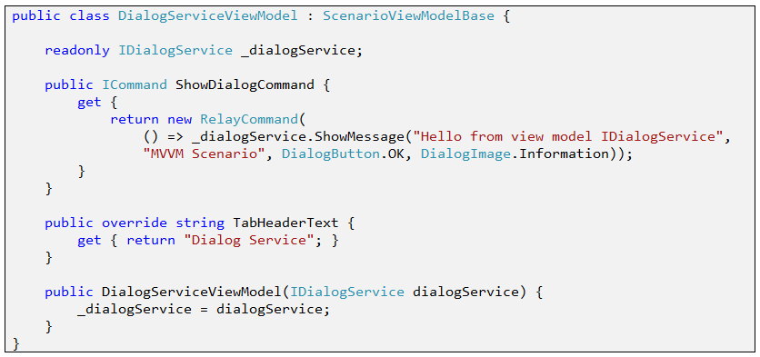
IDialogService Interface
Loose coupling
Notice the ShowMessage arguments; see the abstraction?

Slide 8
Resolving Interface Concrete Types
Dependency Injection (Unity or other DI framework)
MEF Dependency Resolution
Service Locator
Poor Mans DI (roll you own constructor injection)
Provide two constructors, one empty, one will all the parameters. The empty constructor just passes the default values, unit tests pass in other test mocks objects.
Prefer Unity or MEF over Poor Mans DI.
Prefer to not pass the DI container into constructors.

Slide 9
Demo
Dialog and Interaction Request
MVVM Training Scenarios

Slide 10
Contact
Twitter: @kdawg02
Blogs
http://karlshifflett.wordpress.com/
http://blogs.msdn.com/b/kashiffl/
http://blogs.msdn.com/b/wpfsldesigner/
Links
http://compositewpf.codeplex.com/
http://msdn.microsoft.com/en-us/practices/default.aspx
Loose Coupling Post
http://loosecouplings.blogspot.com/2011/01/dependency-injection-using-di-container.html
Dependency Injection in .NET
http://www.manning.com/seemann/

Slide 11


